Slide 1
Renal pharmacology

Slide 2
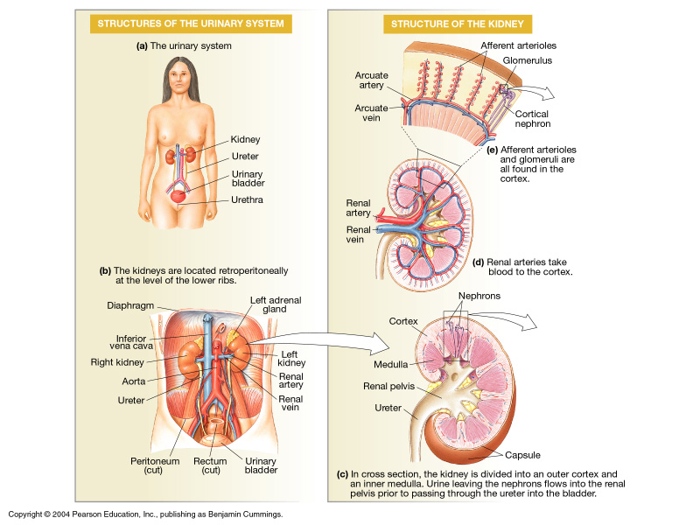
Gross Anatomy of the Kidney

Slide 3
Major Functions of the Kidneys
1. Regulation of:
body fluid osmolarity and volume
electrolyte balance
acid-base balance
blood pressure
2. Excretion of
metabolic products
foreign substances (pesticides, chemicals etc.)
excess substance (water, etc)
3. Secretion of
erythropoietin
1,25-dihydroxy vitamin D₃ (vitamin D activation)
renin
prostaglandin

Slide 4
Section 1 Characteristics of Renal Structure and Function
Physiological Anatomy of the Kidney

Slide 5
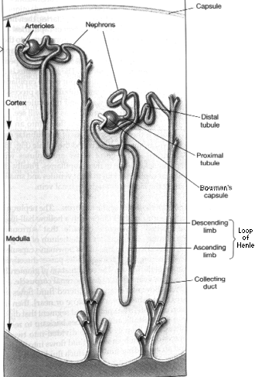
Nephron and
Collecting Duct
Nephron: The functional unit of the kidney
Each kidney is made up of about 1 million nephrons
Each nephrons has two major components:
A glomerulus
A long tube

Slide 6
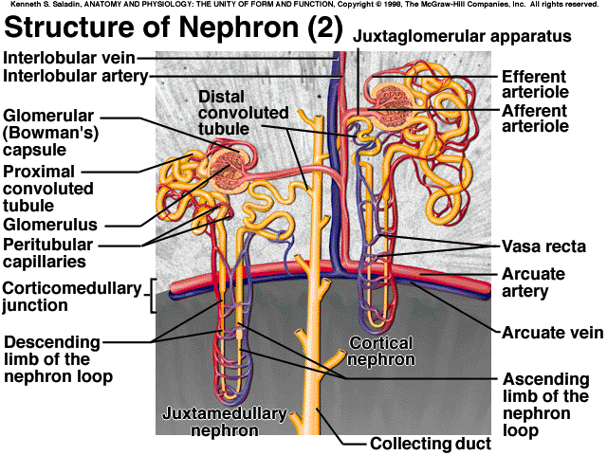
The Nephron
Structure of nephron
  glomerulus
  proximal convoluted tubule (pct)
  loop of Henle
    descending limb
    ascending limb
  distal convoluted tubule
many nephrons connect to collecting duct
Blood flow -
  afferent arteriole
  efferent arteriole
  Peritubular capillaries
  vasa recta

Slide 7
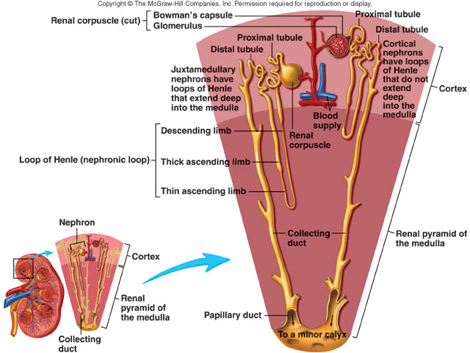
Cortical nephron
Juxtamedullary
nephron

Slide 8
Anatomy of Kidney
Cortical nephron – glomeruli in outer cortex & short loops of Henle that extend only short distance into medulla-- blood flow through cortex is rapid – majority of nephrons are cortical – cortical interstitial fluid 300 mOsmolar
Juxtamedullary nephron – glomeruli in inner part of cortex & long loops of Henle which extend deeply into medulla.– blood flow through vasa recta in medulla is slow – medullary interstitial fluid is hyperosmotic – this nephron maintains osmolality in addition to filtering blood and maintaining acid-base balance

Slide 9
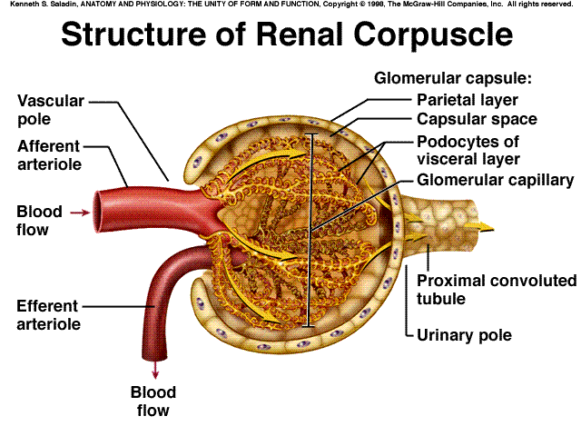
The Renal Corpuscle
Composed of Glomerulus and Bowman’s capsule

Slide 10
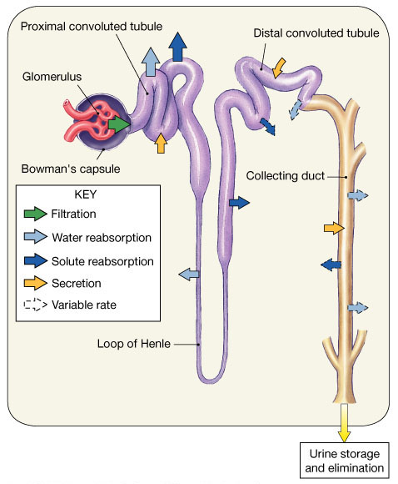
Renal tubules and collecting duct

Slide 11
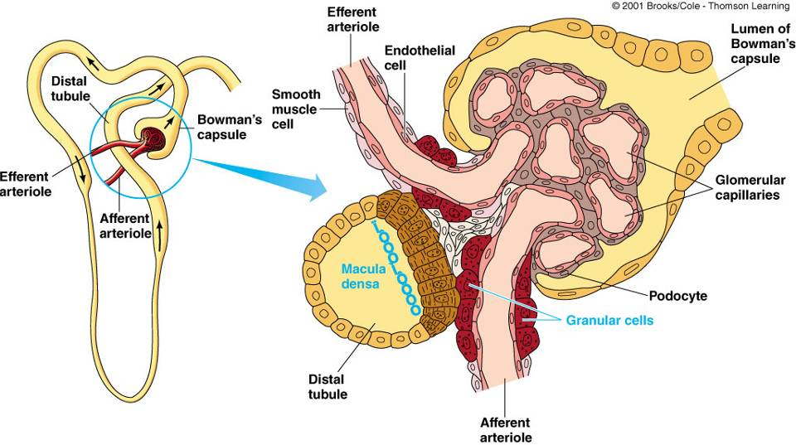
2. The juxtaglomerular apparatus
Including macula densa, extraglumerular mesangial cells, and juxtaglomerular (granular cells) cells

Slide 12
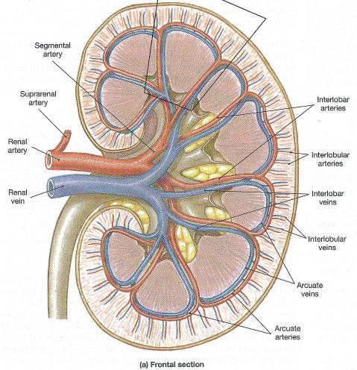
3. Blood Supply to the Kidney
The renal artery -- segmental arteries -- interlobar arteries that communicate with one another via arcuate arteries.
The arcuate arteries give off branches called interlobular arteries that extend into the cortex.
Venous return of blood is via similarly named veins.

Slide 13
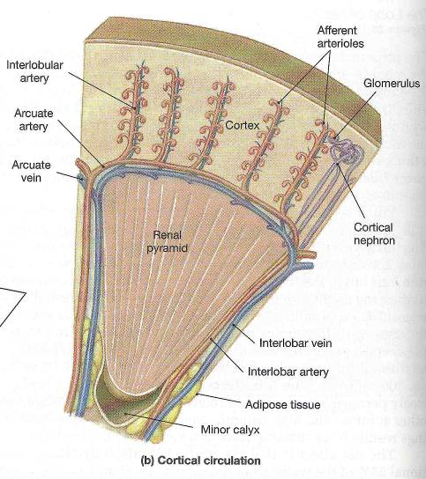
Blood Supply to the Kidney
The interlobular arteries --afferent arterioles -- glomerulus - efferent arterioles --capillary network surrounding the tubule system of the nephron.
The interlobular veins are then the collecting vessel of the nephron capillary system.

Slide 14
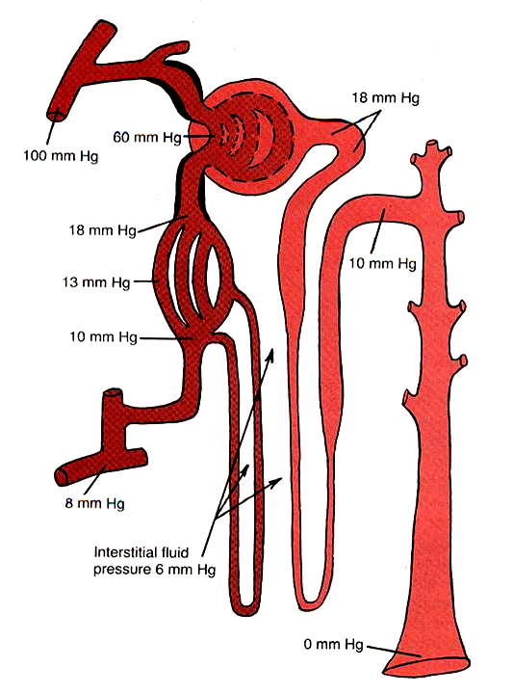
Characteristics of the renal blood flow:
1, high blood flow. 1200 ml/min, or 21 percent of the cardiac output. 94% to the cortex
2, Two capillary beds
High hydrostatic pressure in glomerular capillary (about 60 mmHg) and low hydrostatic pressure in peritubular capillaries (about 13 mmHg)
Vasa Recta

Slide 15
Blood flow in kidneys and other organs
Organ | Approx. blood flow (mg/min/g of tissue) | A-V O₂ difference (ml/L)
Kidney | 4.00 | 12-15 (depends on reabsorption of Na⁺ ⁾
Heart | 0.80 | 96
Brain | 0.50 | 48
Skeletal muscle (rest) | 0.05 | -
Skeletal muscle (max. exercise) | 1.00 | -

Slide 16
Section 2 Function of Glomerular Filtration

Slide 17
Functions of the Nephron
Reabsorption
Secretion
Excretion
Filtration

Slide 18
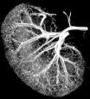
HUMAN RENAL PHYSIOLOGY
Four Main Processes:
      Filtration
      Reabsorbtion
      Secretion
      Excretion

Slide 19
HUMAN RENAL PHYSIOLOGY
Functions of the Kidney:
  Filtration:
      First step in urine formation
      Bulk transport of fluid from blood to kidney tubule
        Isosmotic filtrate
        Blood cells and proteins don’t filter
      Result of hydraulic pressure
      GFR = 180 L/day

Slide 20
HUMAN RENAL PHYSIOLOGY
Functions of the Kidney:
  Reabsorbtion:
    Process of returning filtered material to bloodstream
    99% of what is filtered
    May involve transport protein(s)
    Normally glucose is totally reabsorbed

Slide 21
HUMAN RENAL PHYSIOLOGY
Functions of the Kidney:
  Secretion:
      Material added to lumen of kidney from blood
      Active transport (usually) of toxins and foreign substances
        Saccharine
        Penicillin

Slide 22
HUMAN RENAL PHYSIOLOGY
Functions of the Kidney:
  Excretion:
      Loss of fluid from body in form of urine
      Amount = Amount + Amount -- Amount
      of Solute Filtered Secreted Reabsorbed
      Excreted

Slide 23
Glomerular Filtration

Slide 24
Glomerular filtration
Occurs as fluids move across the glomerular capillary in response to glomerular hydrostatic pressure
  blood enters glomerular capillary
  filters out of renal corpuscle
    large proteins and cells stay behind
    everything else is filtered into nephron
    glomerular filtrate
      plasma like fluid in glomerulus

Slide 25
Factors that determine the glomerular filterability
Molecular weight
Charges of the molecule

Slide 26
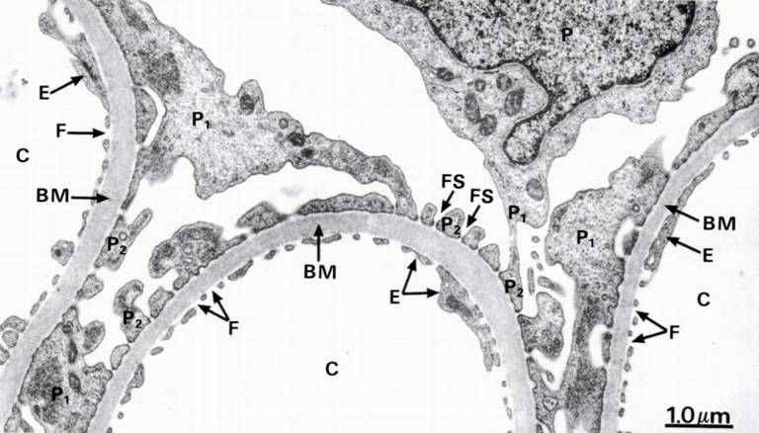
Filtration Membrane
One layer of glomerular capillary cells
  Basement membrane(lamina densa)
  One layer of cells in Bowman’s capsule: Podocytes have foot like projections(pedicels) with filtration slits in between
C: capillary
BM: basal membrane
P podocytes
FS: filtration slit

Slide 27
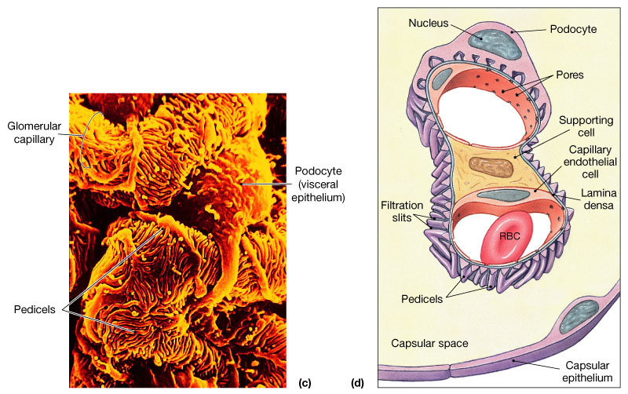

Slide 28
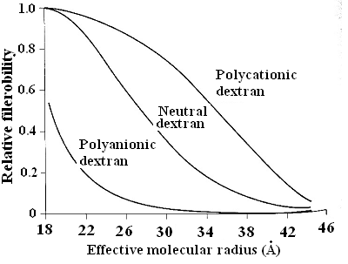
Dextran filterability
Stanton BA & Koeppen BM:
‘The Kidney’ in Physiology,
Ed. Berne & Levy, Mosby, 1998
2934

Slide 29
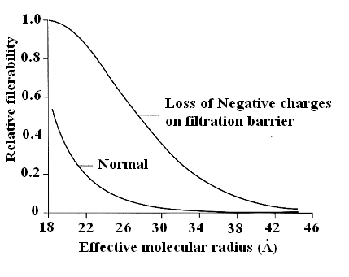
Protein filtration:
influence of negative charge on glomerular wall

Slide 30
Filterablility of plasma constituents vs. water
Constituent | Mol. Wt. | Filteration ratio
Urea | 60 | 1.00
Glucose | 180 | 1.00
Inulin | 5,500 | 1.00
Myoglobin | 17,000 | 0.75
Hemoglobin | 64,000 | 0.03
Serum albumin | 69,000 | 0.01

Slide 31
Starling Forces Involved in Filtration:
What forces favor/oppose filtration?

Slide 32
Glomerular filtration
Mechanism: Bulk flow
Direction of movement : From glomerular capillaries to capsule space
Driving force: Pressure gradient (net filtration pressure, NFP)
Types of pressure:
Favoring Force: Capillary Blood Pressure (BP), Opposing Force: Blood colloid osmotic pressure(COP) and Capsule Pressure (CP)

Slide 33
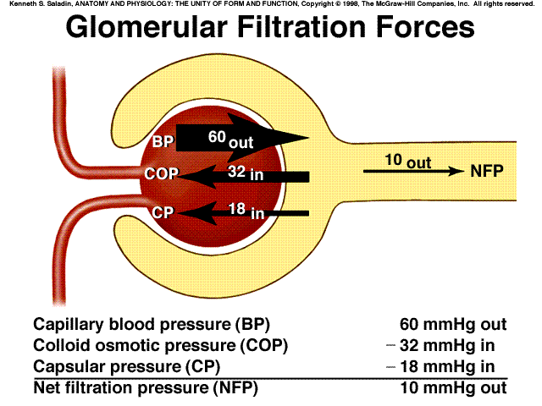

Slide 34
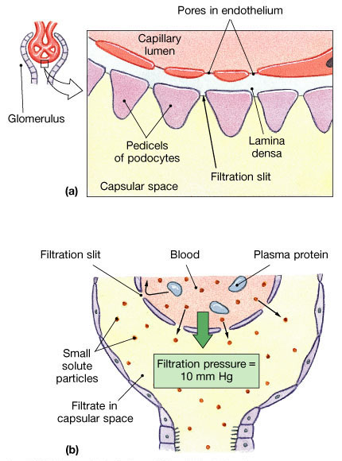
Glomerular Filtration
Figure 26.10a, b

Slide 35
Glomerular filtration rate (GFR)
Amount of filtrate produced in the kidneys each minute. 125mL/min = 180L/day
Factors that alter filtration pressure change GFR. These include:
  Increased renal blood flow -- Increased GFR
  Decreased plasma protein -- Increased GFR. Causes edema.
  Hemorrhage -- Decreased capillary BP -- Decreased GFR

Slide 36
GFR regulation : Adjusting blood flow
GFR is regulated using three mechanisms
  1. Renal Autoregulation
  2. Neural regulation
  3. Hormonal regulation
  All three mechanism adjust renal blood pressure and resulting blood flow

Slide 37
1. Renal autoregulation

Slide 38
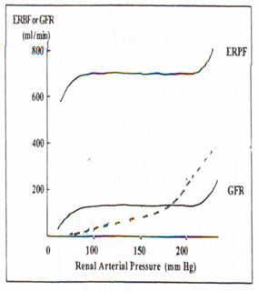
ERPF: experimental renal plasma flow
GFR: glomerular filtration rate
Urine
(6 ml/min)

Slide 39
Mechanism?

Slide 40
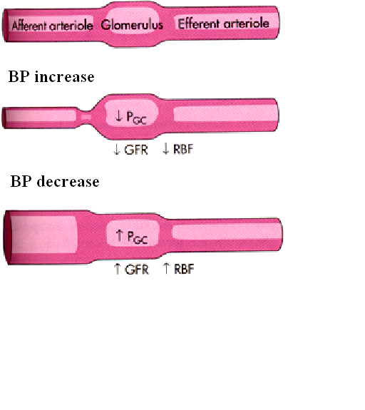
1) Myogenic Mechanism of the autoregulation
Blood Flow = Capillary Pressure / Flow resistance

Slide 41
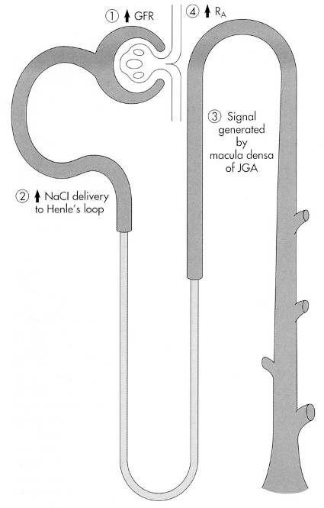
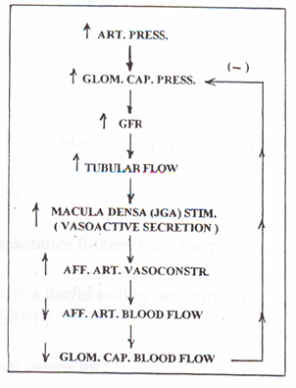
2) Tubuloglomerular feedback
2934

Slide 42
2. Neural regulation of GFR
Sympathetic nerve fibers innervate afferent and efferent arteriole
Normally sympathetic stimulation is low but can increase during hemorrhage and exercise
Vasoconstriction occurs as a result which conserves blood volume(hemorrhage)and permits greater blood flow to other body parts(exercise)

Slide 43
3. Hormonal regulation of GFR
Several hormones contribute to GFR regulation
Angiotensin II. Produced by Renin, released by JGA cells is a potent vasoconstrictor. Reduces GFR
ANP(released by atria when stretched) increases GFR by increasing capillary surface area available for filtration
NO
Endothelin
Prostaglandin E2

Slide 44
Measuring GFR
125ml of plasma is cleared/min in glomerulus(or 180L/day)
If a substance is filtered but neither reabsorbed nor secreted, then the amount present in urine is its plasma clearance(amount in plasma cleared/min by glomerulus)
If plasma conc. Is 3mg/L then
3 180/day = 540mg/day
(known) (unknown) (known)

Slide 45
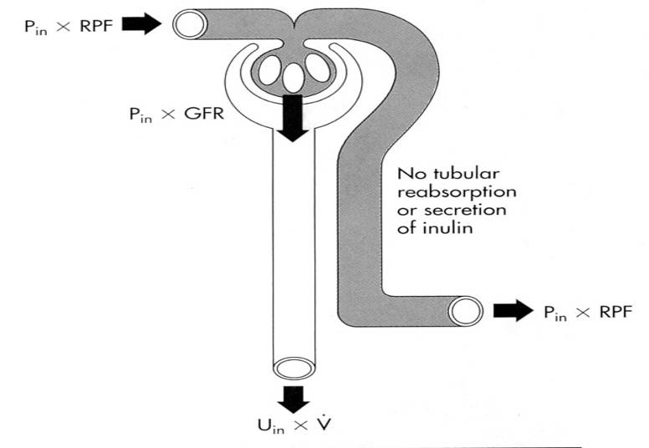
Renal handling of inulin
Amount filtered = Amount excreted
P_{in} x GFR U_{in} x V

Slide 46
Qualities of agents to measure GFR
Inulin: (Polysaccharide from Dahalia plant)
Freely filterable at glomerulus
Does not bind to plasma proteins
Biologically inert
Non-toxic, neither synthesized nor metabolized in kidney
Neither absorbed nor secreted
Does not alter renal function
Can be accurately quantified
Low concentrations are enough (10-20 mg/100 ml plasma)

Slide 47
Qualities of agents to measure GFR
Creatinine:
End product of muscle creatine metabolism
Used in clinical setting to measure GFR but less accurate than inulin method
Small amount secrete from the tubule

Slide 48
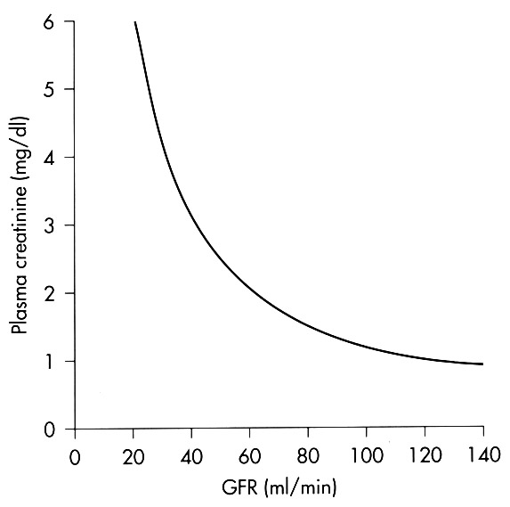
Plasma creatinine level vs. GFR
2934

Slide 49
Section 3
Reabsorption and Secretion
Concept of Reabsorption and Secretion

Slide 50
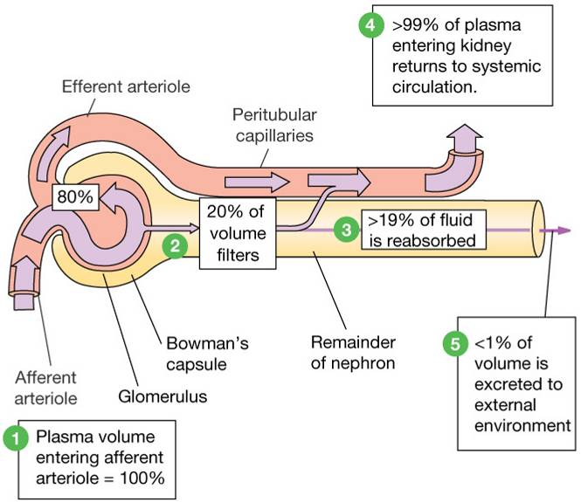
GFR ≈ 125 ml/min (180L/day)
(about 1% is excreted)

Slide 51
Filtration, reabsoption, and excretion rates of substances by the kidneys
Filtered Reabsorbed Excreted Reabsorbed
(meq/24h) (meq/24h) (meq/24h) (%)
Glucose (g/day) 180 180 0 100
Bicarbonate (meq/day) 4,320 4,318 2 > 99.9
Sodium (meq/day) 25,560 25,410 150 99.4
Chloride (meq/day) 19,440 19,260 180 99.1
Water (l/day) 169 167.5 1.5 99.1
Urea (g/day) 48 24 24 50
Creatinine (g/day) 1.8 0 1.8 0

Slide 52
Two pathways of the absorption:
Transcellular
Pathway
Paracellular
transport
Plasma
Lumen
Cells

Slide 53
Mechanism of Transport
1, Primary Active Transport
2, Secondary Active Transport
3, Pinocytosis
4, Passive Transport

Slide 54
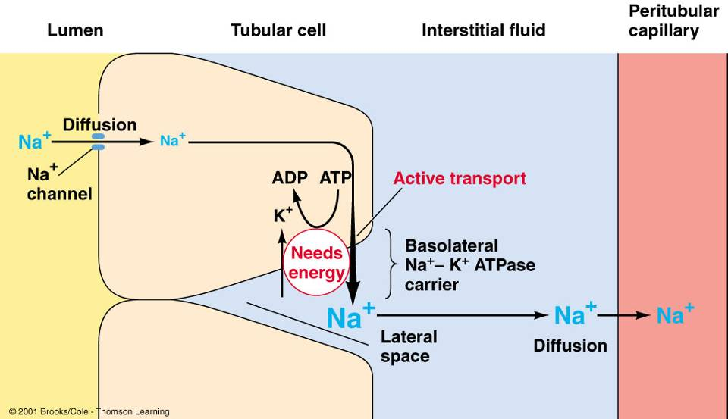
Primary Active Transport

Slide 55
Secondary active transport
Interstitial
Fluid
Tubular
lumen
Interstitial
Fluid
Tubular
lumen
Tubular Cell
Tubular Cell
co-transport counter-transport
(symport) (antiport)
out in
out in
Na⁺
Na⁺
glucose
H⁺
Co-transporters will move one moiety, e.g. glucose, in the same direction as the Na⁺.
Counter-transporters will move one moiety, e.g. H⁺, in the opposite direction to the Na⁺.

Slide 56
Pinocytosis:
Some parts of the tubule, especially the proximal tubule, reabsorb large molecules such as proteins by pinocytosis.

Slide 57
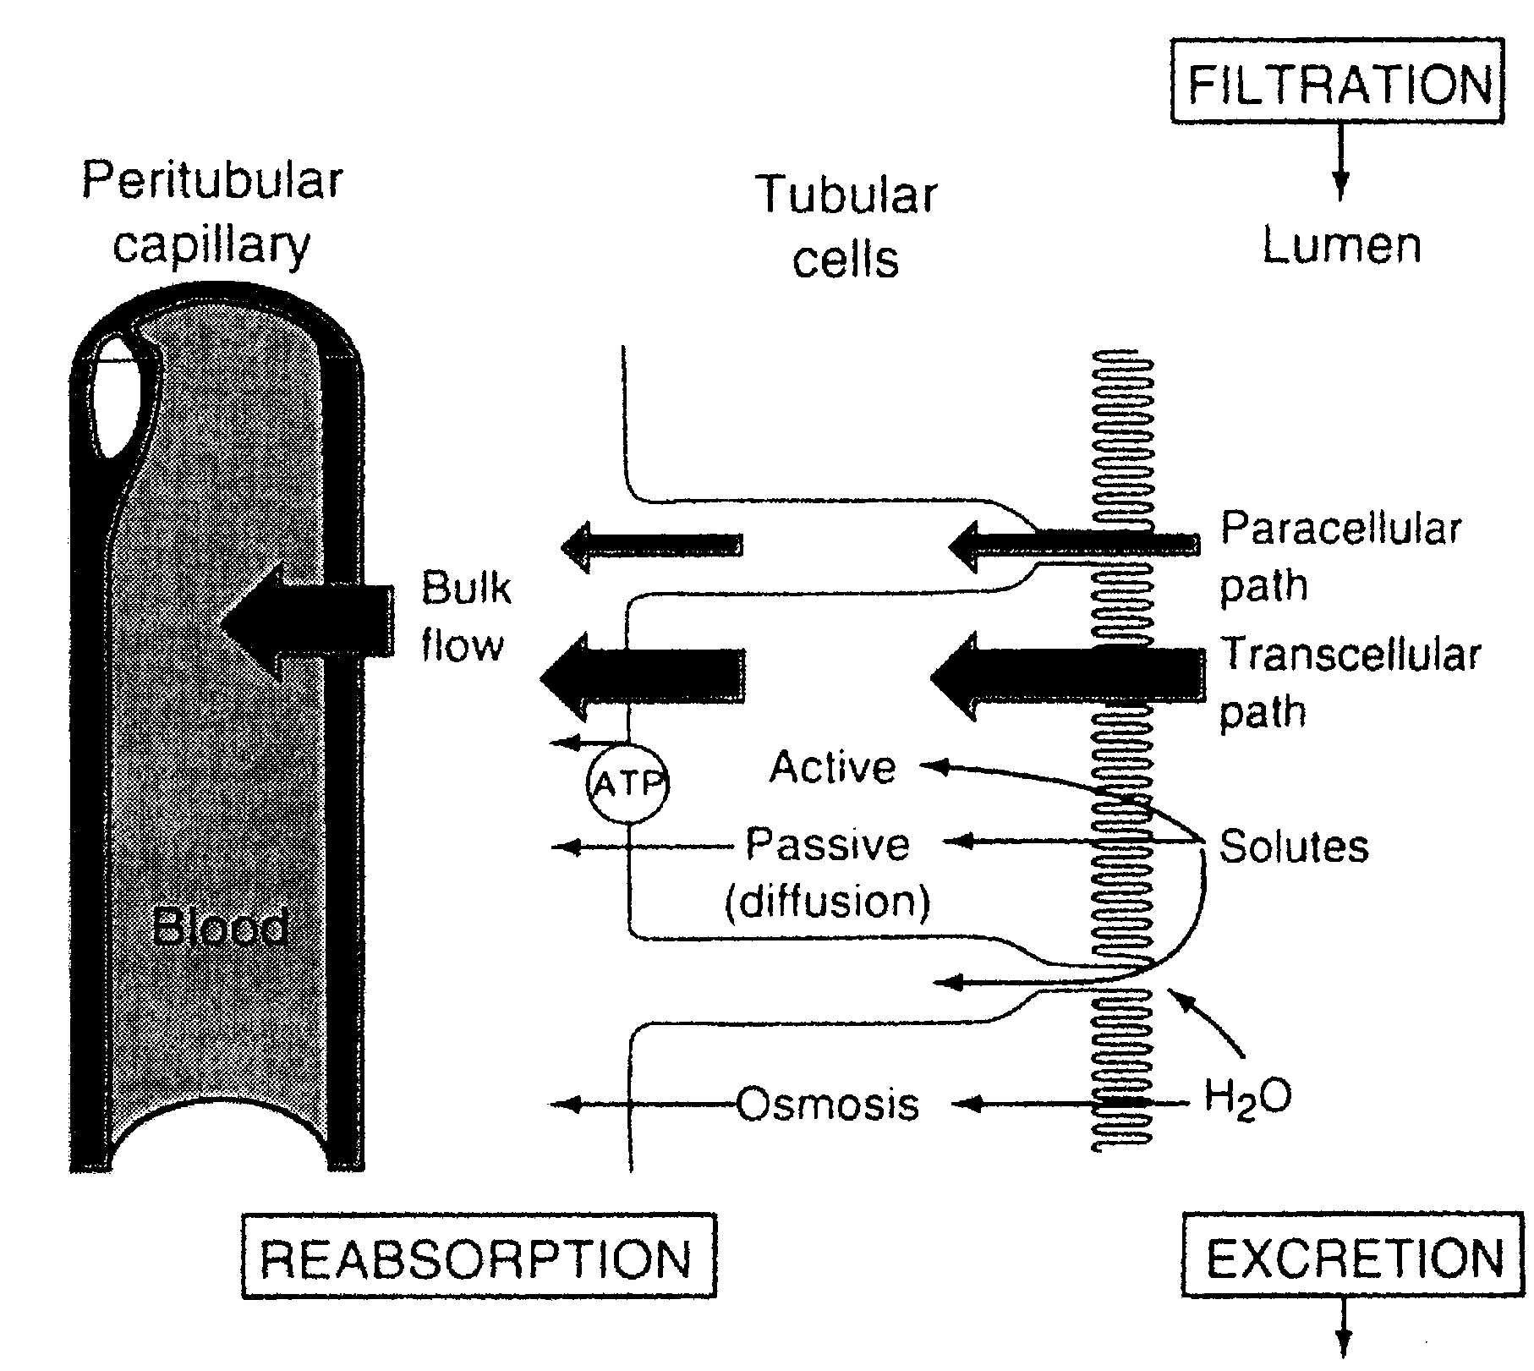
Passive Transport
Diffusion

Slide 58
1. Transportation of Sodium, Water and Chloride
Sodium, water and chloride reabsorption in proximal tubule
Proximal tubule, includes the proximal convoluted tubule and thick descending segment of the loop

Slide 59
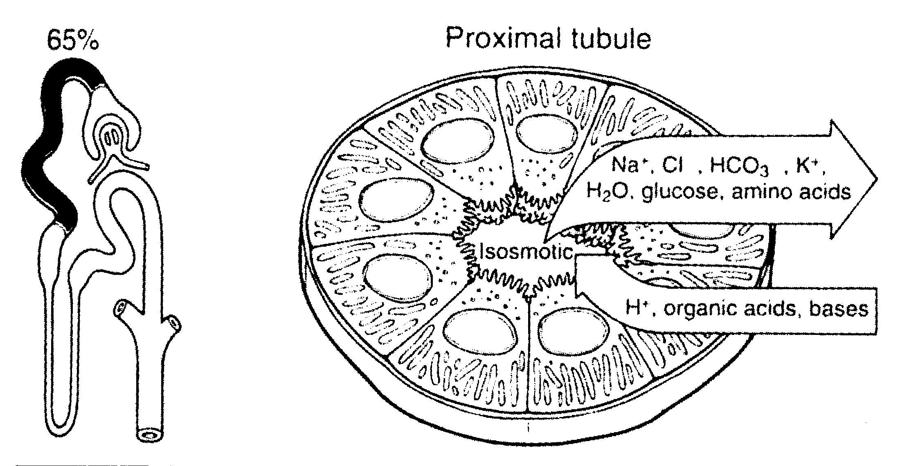
Reabsorb about 65 percent of the filtered sodium, chloride, bicarbonate, and potassium and essentially all the filtered glucose and amino acids.
Secrete organic acids, bases, and hydrogen ions into the tubular lumen.

Slide 60
Sodium, water and chloride reabsorption in proximal tubule
The sodium-potassium ATPase: major force for reabsorption of sodium, chloride and water
In the first half of the proximal tubule, sodium is reabsorbed by co-transport along with glucose, amino acids, and other solutes.
In the second half of the proximal tubule, sodium reabsorbed mainly with chloride ions.

Slide 61
Sodium, water and chloride reabsorption in proximal tubule
The second half of the proximal tubule has a relatively high concentration of chloride (around 140mEq/L) compared with the early proximal tubule (about 105 mEq/L)
In the second half of the proximal tubule, the higher chloride concentration favors the diffusion of this ion from the tubule lumen through the intercellular junctions into the renal interstitial fluid.

Slide 62
(2) Sodium and water transport in the loop of Henle
The loop of Henle consists of three functionally distinct segments:
the thin descending segment,
the thin ascending segment,
and the thick ascending segment.

Slide 63
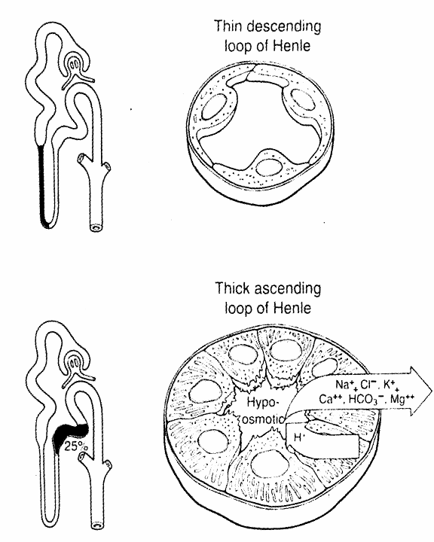
Highly permeable to water and moderately permeable to most solutes
but has few mitochondria and little or no active reabsorption.
Reabsorbs about 25% of the filtered loads of sodium, chloride, and potassium, as well as large amounts of calcium, bicarbonate, and magnesium.
This segment also secretes hydrogen ions into the tubule

Slide 64
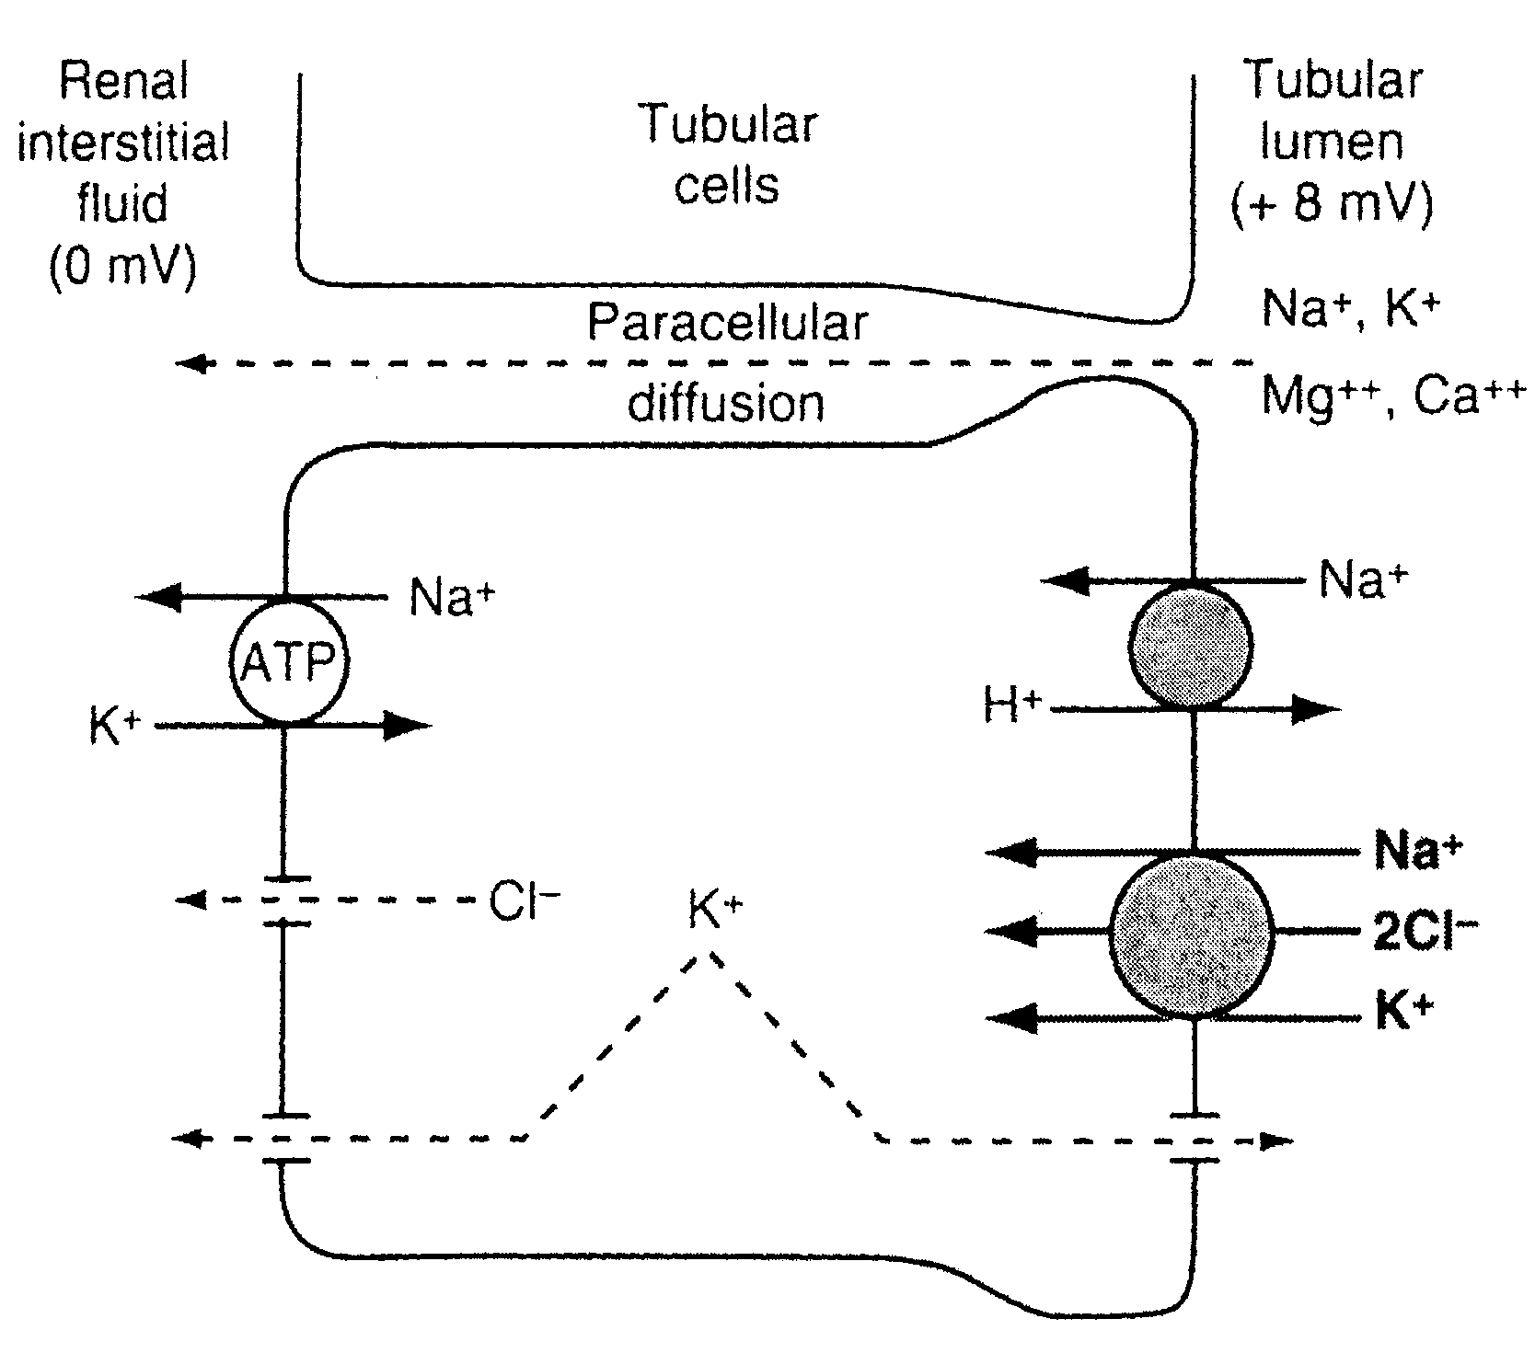
Mechanism of sodium, chloride, and potassium transport in the thick ascending loop of Henle

Slide 65
2. Glucose Reabsorption
Glucose is reabsorbed along with Na⁺ in the early portion of the proximal tubule.
Glucose is typical of substances removed from the urine by secondary active transport.
Essentially all of the glucose is reabsorbed, and no more than a few milligrams appear in the urine per 24 hours.

Slide 66
The amount reabsorbed is proportionate to the amount filtered and hence to the plasma glucose level (P_{G}) times the GFR up to the transport maximum (Tm_{G});
But when the Tm_{G} is exceeded, the amount of glucose in the urine rises
The Tm_{G} is about 375 mg/min in men and 300 mg/min in women.

Slide 67
GLUCOSE REABSORPTION HAS A TUBULAR MAXIMUM
Glucose
Reabsorbed
mg/min
Filtered
Excreted
Reabsorbed
Renal threshold (300mg/100 ml)
Plasma Concentration of Glucose

Slide 68
The renal threshold for glucose is the plasma level at which the glucose first appears in the urine.
One would predict that the renal threshold would be about 300 mg/dl – ie, 375 mg/min (Tm_{G}) divided by 125 mL/min (GFR).
However, the actual renal threshold is about 200 mg/dL of arterial plasma, which corresponds to a venous level of about 180 mg/dL.

Slide 69
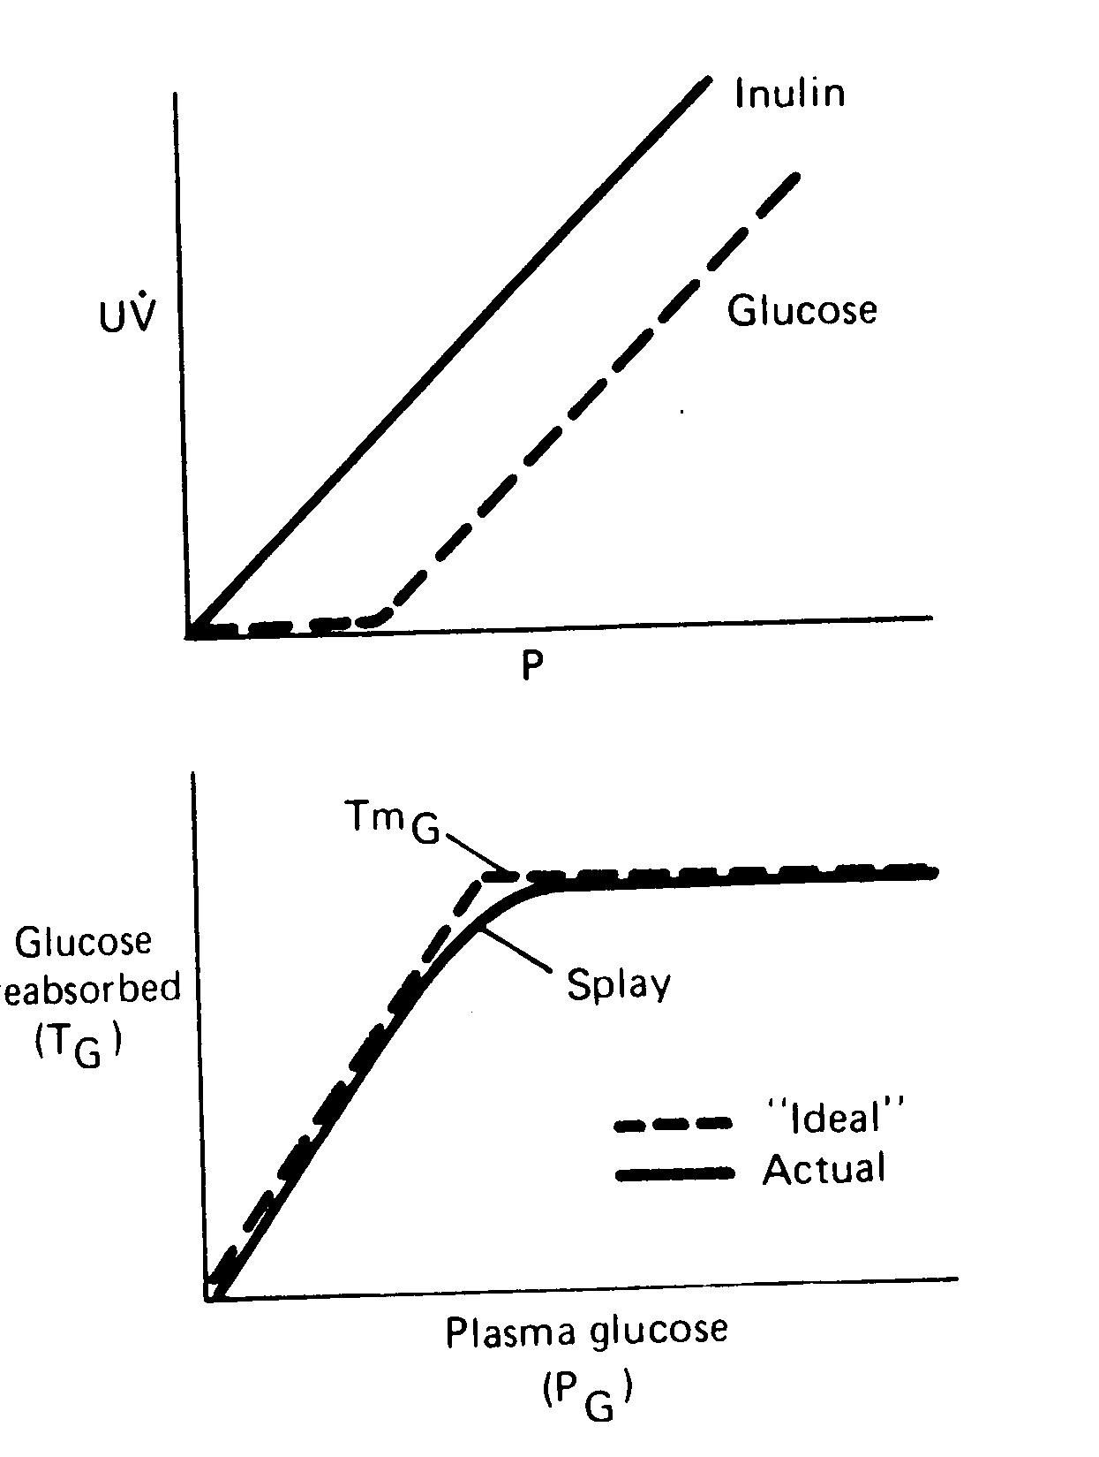
Top: Relationship between the plasma level (P) and excretion (UV) of glucose and inulin
Bottom: Relationship between the plasma glucose level (P_{G}) and amount of glucose reabsorbed (T_{G}).

Slide 70
3. Hydrogen Secretion and Bicarbonate Reabsorption.
Hydrogen secretion through secondary Active Transport.
Mainly at the proximal tubules, loop of Henle, and early distal tubule ;
More than 90 percent of the bicarbonate is reabsorbed (passively ) in this manner .

Slide 71
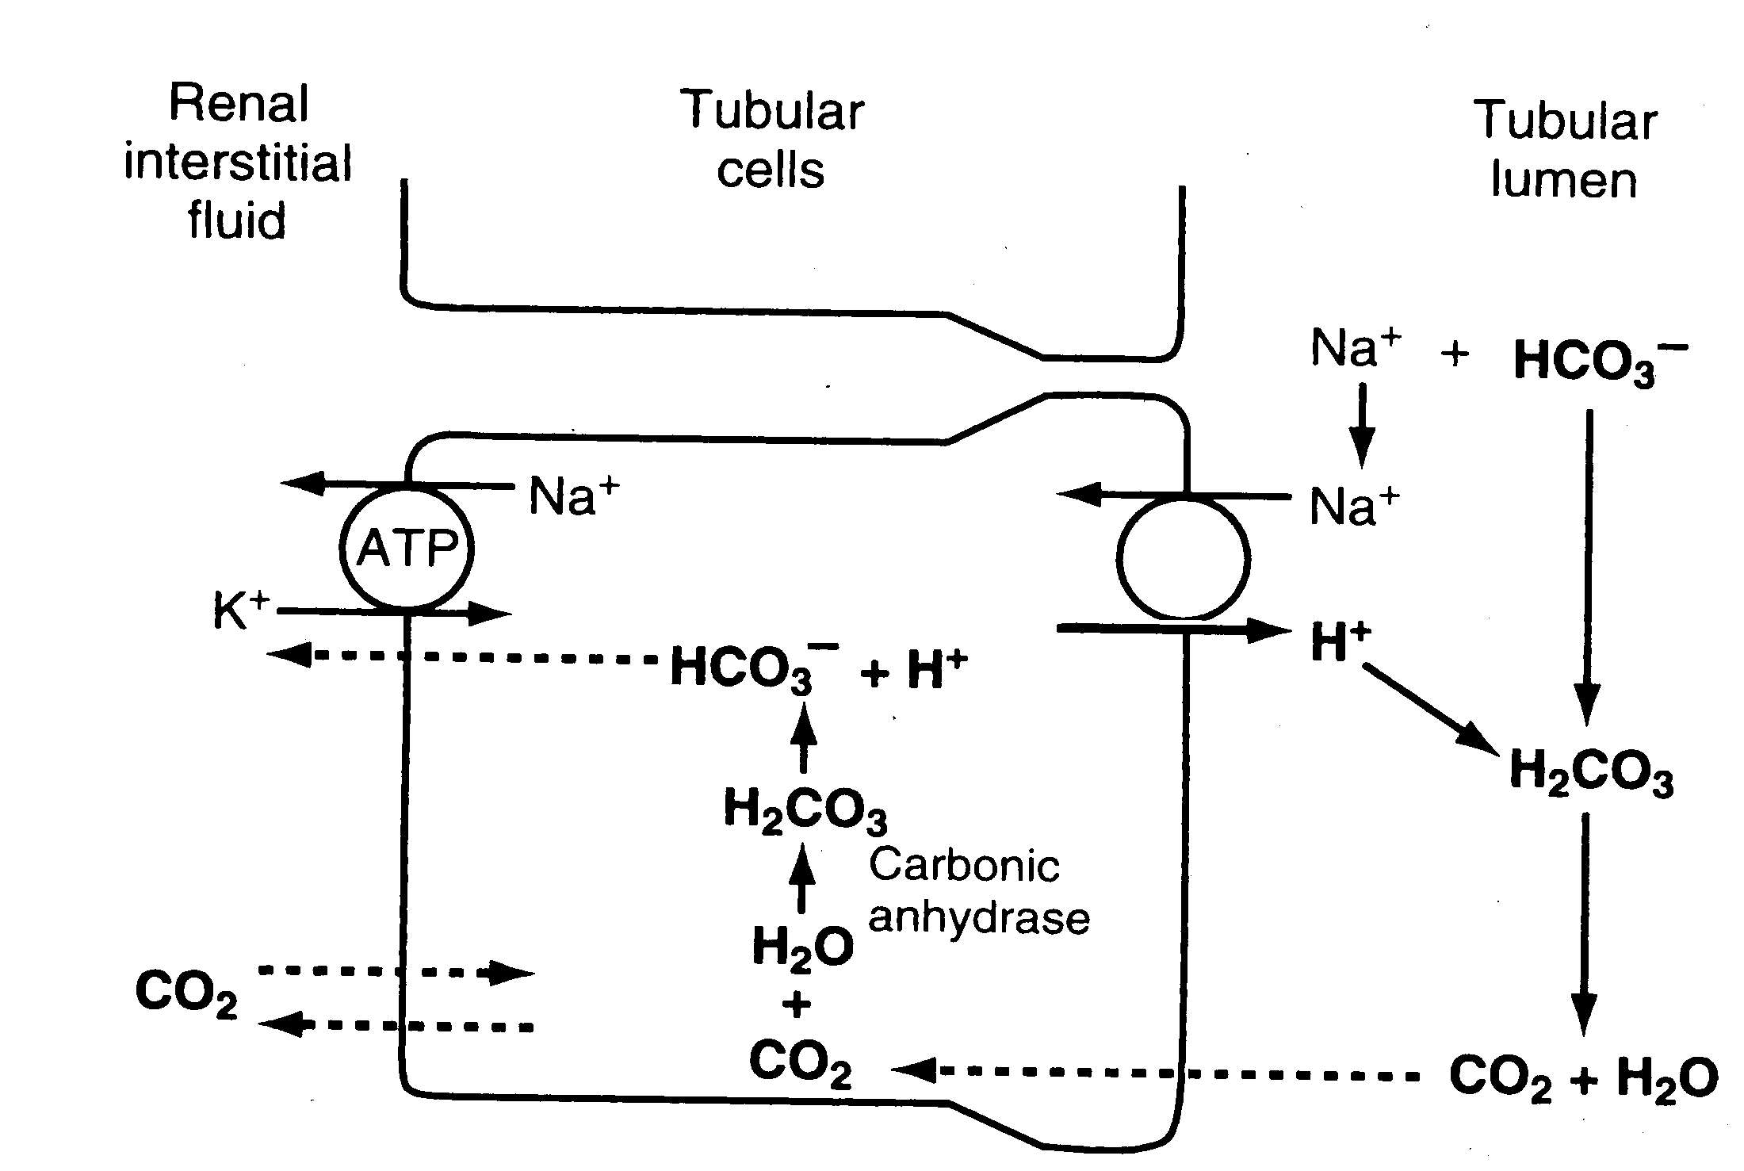
Secondary Active Transport

Slide 72
(2) Primary Active Transport
Beginning in the late distal tubules and continuing through the reminder of the tubular system
It occurs at the luminal membrane of the tubular cell
Hydrogen ions are transported directly by a specific protein, a hydrogen-transporting ATPase (proton pump).

Slide 73
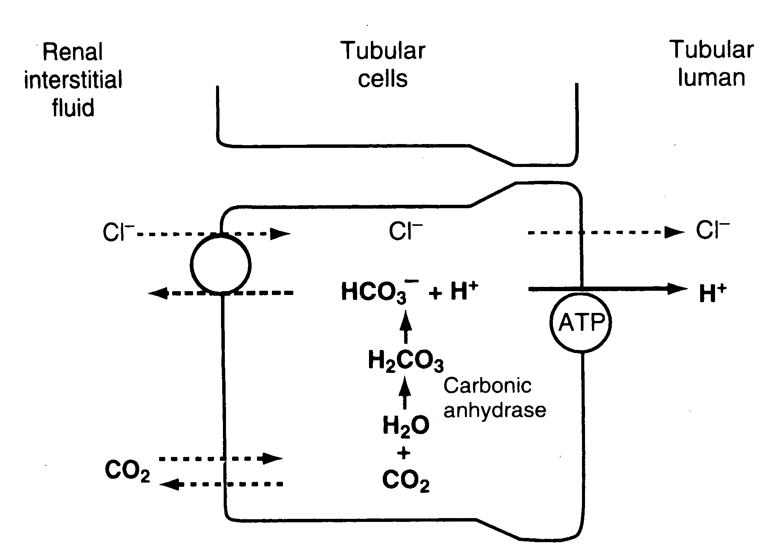
Primary Active Transport

Slide 74
Hydrogen Secretion—through proton pump:
accounts for only about 5 percent of the total hydrogen ion secreted
Important in forming a maximally acidic urine.
Hydrogen ion concentration can be increased as much as 900-fold in the collecting tubules.
Decreases the pH of the tubular fluid to about 4.5, which is the lower limit of pH that can be achieved in normal kidneys.

Slide 75
4. Excretion of Excess Hydrogen Ions and Generation of New Bicarbonate by the Ammonia Buffer System

Slide 76
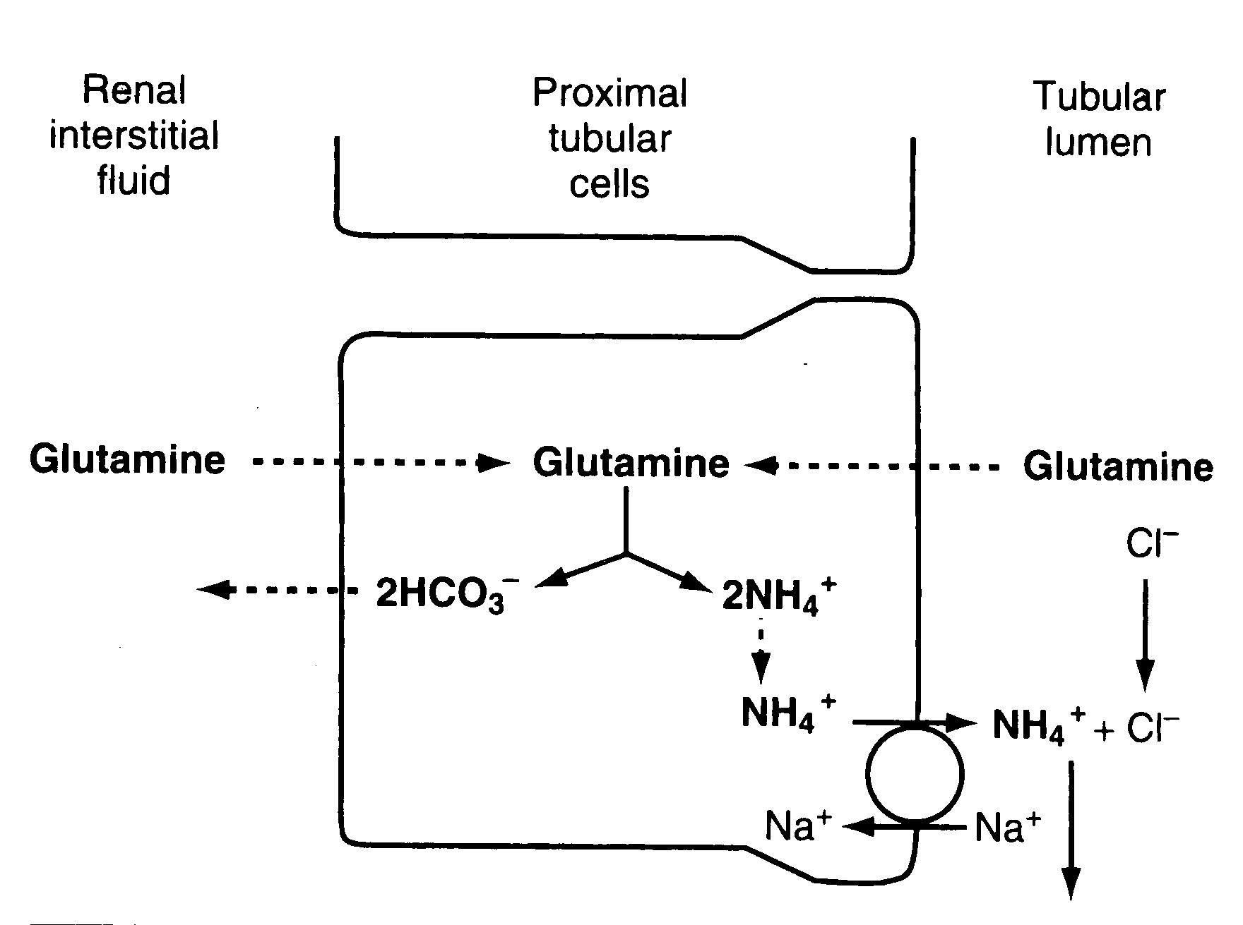
Production and secretion of ammonium ion (NH₄⁺) by proximal tubular cells.

Slide 77
For each molecule of glutamine metabolized in the proximal tubules, two NH₄⁺ ions are secreted into the urine and two HCO₃⁻ ions are reabsorbed into the blood.
The HCO₃⁻ generated by this process constitutes new bicarbonate.

Slide 78
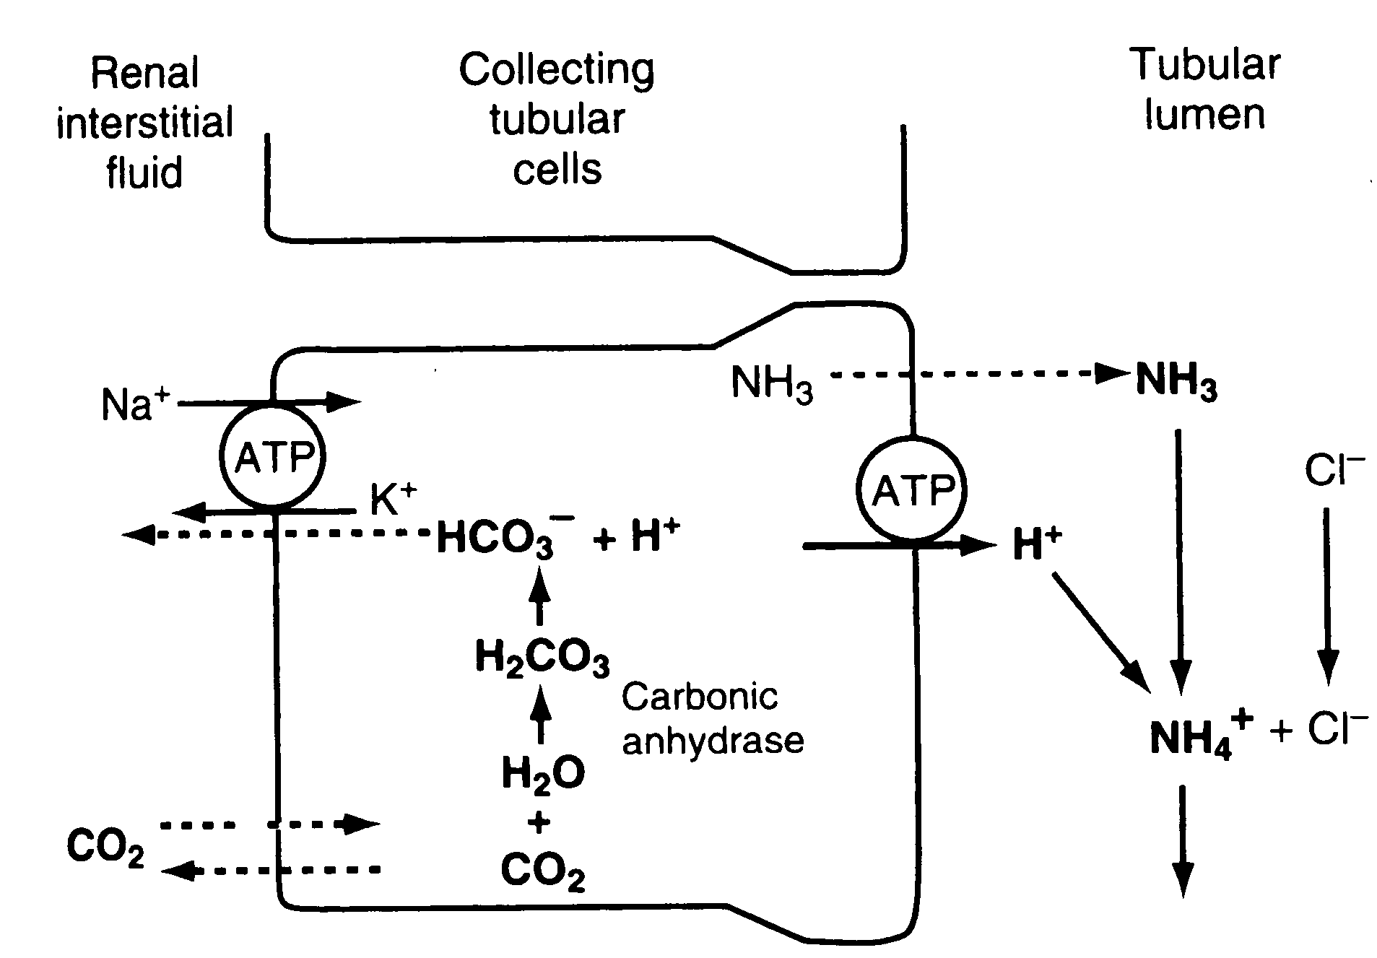
Buffering of hydrogen ion secretion by ammonia (NH₃) in the collecting tubule.

Slide 79
Renal ammonium-ammonia buffer system is subject to physiological control.
An increase in extracellular fluid hydrogen ion concentration stimulates renal glutamine metabolism and, therefore, increase the formation of NH₄⁺ and new bicarbonate to be used in hydrogen ion buffering;
a decrease in hydrogen ion concentration has the opposite effect.

Slide 80
with chronic acidosis, the dominant mechanism by which acid is eliminated of NH₄⁺.
This also provides the most important mechanism for generating new bicarbonate during chronic acidosis.

Slide 81
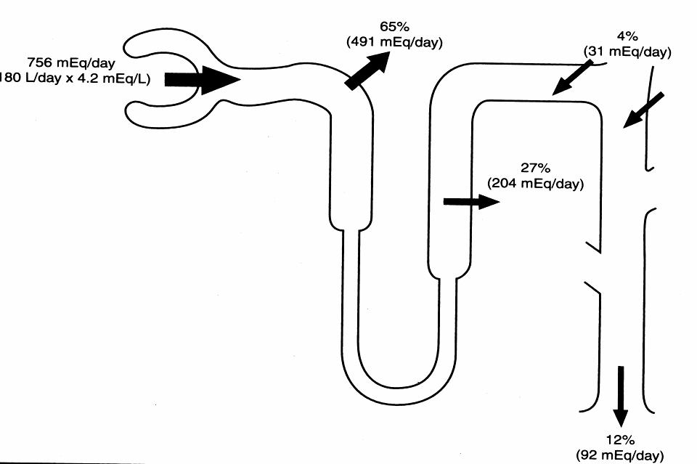
5. Potassium reabsorption and secretion

Slide 82
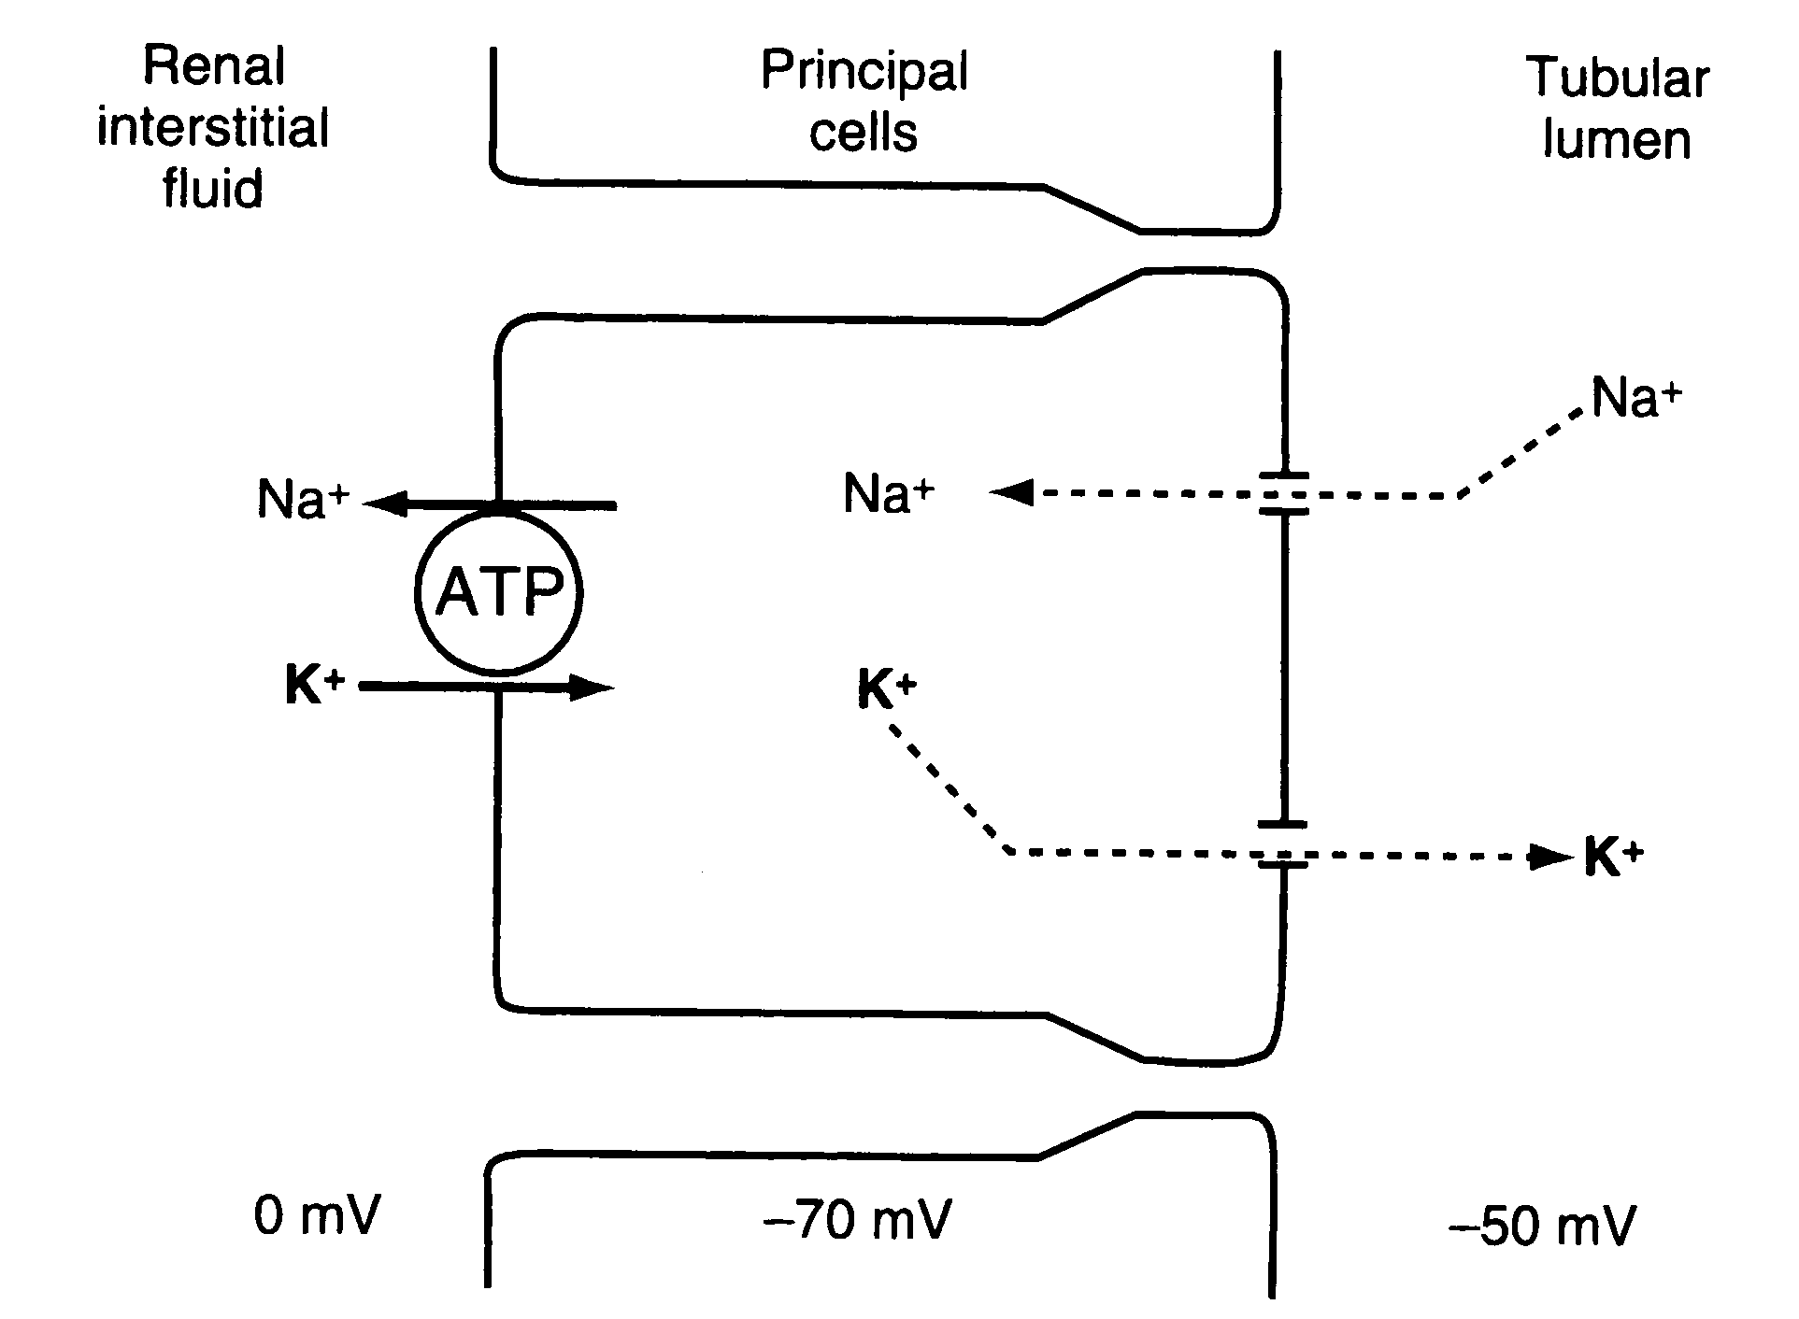
Mechanisms of potassium secretion and sodium reabsorption by the principle cells of the late distal and collecting tubules.

Slide 83
6. Control of Calcium Excretion by the Kidneys
Calcium is both filtered and reabsorbed in the kidneys but not secreted
Only about 50 per cent of the plasma calcium is ionized, with the remainder being bound to the plasma proteins.
Calcium excretion is adjusted to meet the body’s needs.
Parathyroid hormone (PTH) increases calcium reabsorption in the thick ascending loops of Henle and distal tubules, and reduces urinary excretion of calcium

Slide 84
An Overview of Urine Formation

Slide 85
Section 4. Urine Concentration and Dilution
Importance:
When there is excess water in the body and body fluid osmolarity is reduced, the kidney can excrete urine with an osmolarity as low as 50 mOsm/liter, a concentration that is only about one sixth the osmolarity of normal extracellular fluid.
Conversely, when there is a deficient of water and extracellular fluids osmolarity is high, the kidney can excrete urine with a concentration of about 1200 to 1400 mOsm/liter.

Slide 86
The basic requirements for forming a concentrated or diluted urine
(1) the controlled secretion of antidiuretic hormone (ADH), which regulates the permeability of the distal tubules and collecting ducts to water;
(2) a high osmolarity of the renal medullary interstitial fluid, which provides the osmotic gradient necessary for water reabsorption to occur in the presence of high level of ADH.

Slide 87
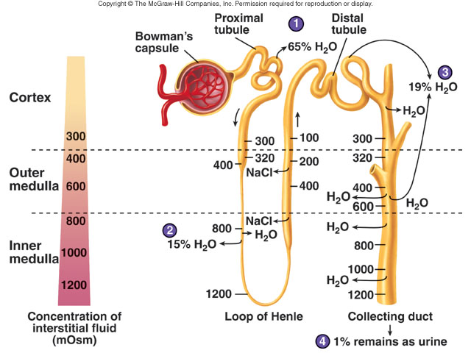

Slide 88
I The Counter-Current Mechanism Produces a Hyperosmotic Renal Medullary Interstitium

Slide 89
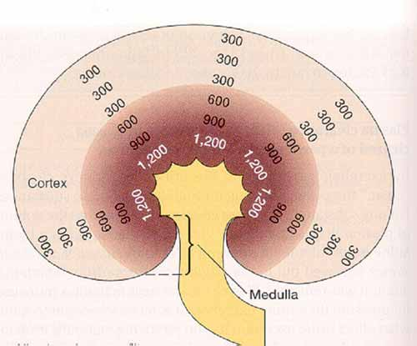
Hyperosmotic Gradient in the Renal Medulla Interstitium

Slide 90
Countercurrent Multiplication and Concentration of Urine

Slide 91
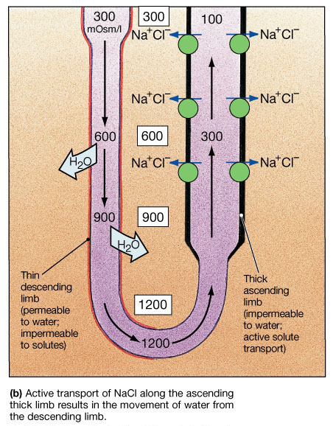
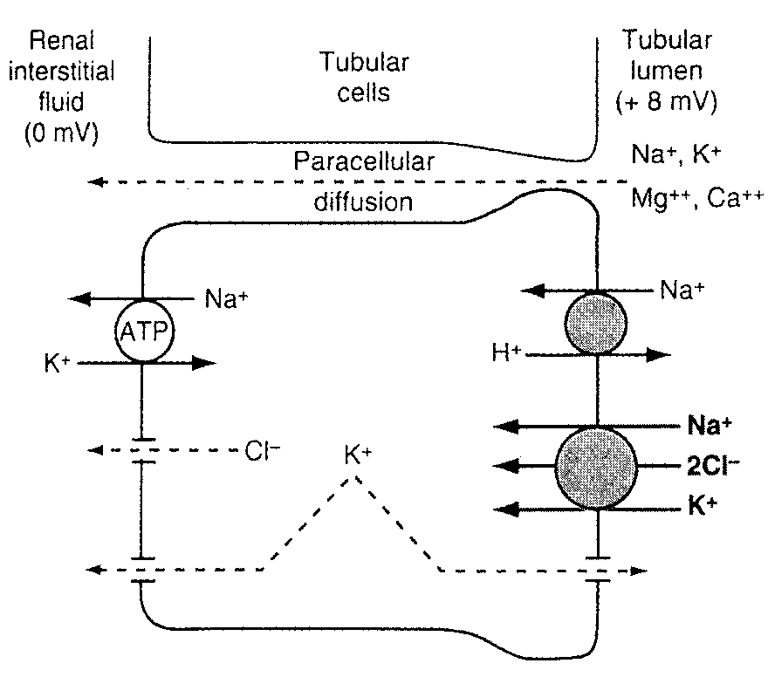

Slide 92
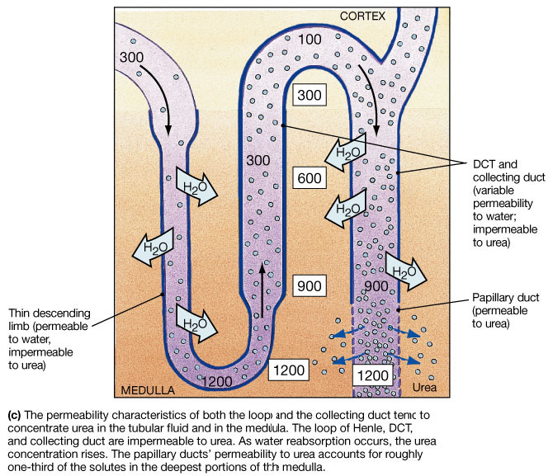
Figure 26.13c

Slide 94
I.II. Counter-current Exchange in the Vesa Recta Preserves Hyperosmolarity of the Renal medulla

Slide 95
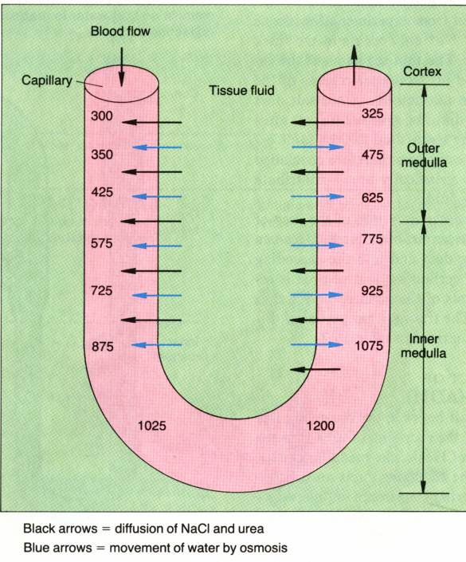
The vasa recta trap salt and urea within the interstitial fluid but transport water out of the renal medulla

Slide 96
III. Role of the Distal Tubule and Collecting Ducts in Forming Concentrated or Diluted urine

Slide 97
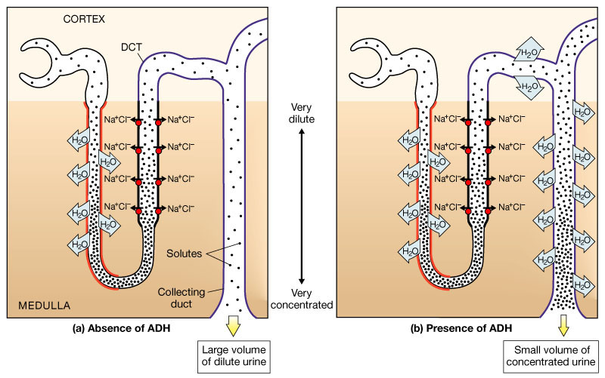
The Effects of ADH on the distal collecting duct and Collecting Ducts
Figure 26.15a, b

Slide 98
The Role of ADH
There is a high osmolarity of the renal medullary interstitial fluid, which provides the osmotic gradient necessary for water reabsorption to occur.
Whether the water actually leaves the collecting duct (by osmosis) is determined by the hormone ADH (anti-diuretic hormone)
Osmoreceptors in the hypothalamus detect the low levels of water (high osmolarity), so the hypothalamus sends an impulse to the pituitary gland which releases ADH into the bloodstream.
ADH makes the wall of the collecting duct more permeable to water.
Therefore, when ADH is present more water is reabsorbed and less is excreted.

Slide 99
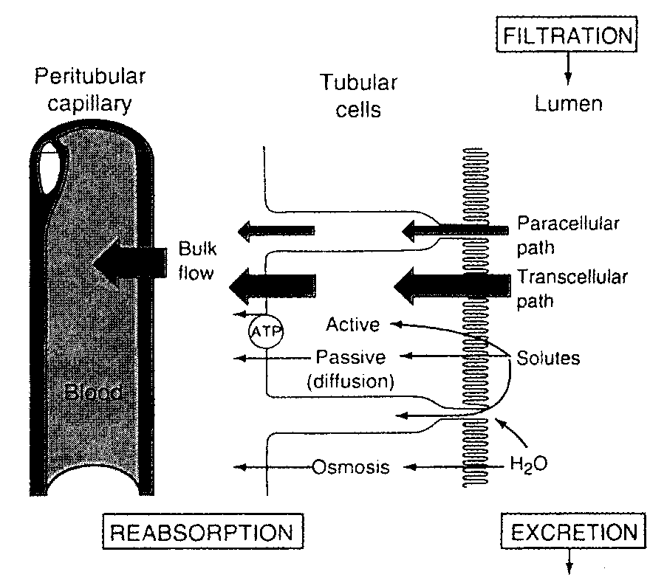
Water reabsorption - 1
Obligatory water reabsorption:
Using sodium and other solutes.
Water follows solute to the interstitial fluid (transcellular and paracellular pathway).
Largely influenced by sodium reabsorption

Slide 100
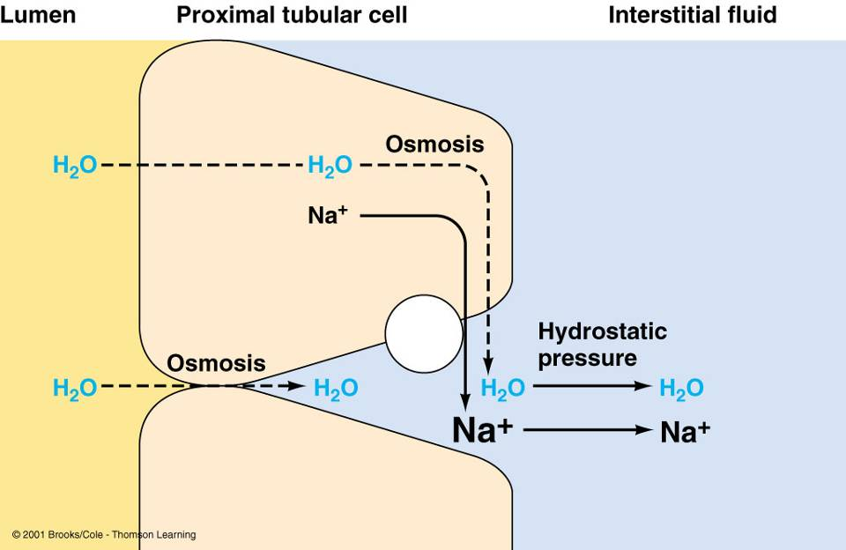
Obligatory water reabsorption

Slide 101
Water reabsorption - 2
Facultative (selective) water reabsorption:
Occurs mostly in collecting ducts
Through the water poles (channel)
Regulated by the ADH

Slide 102
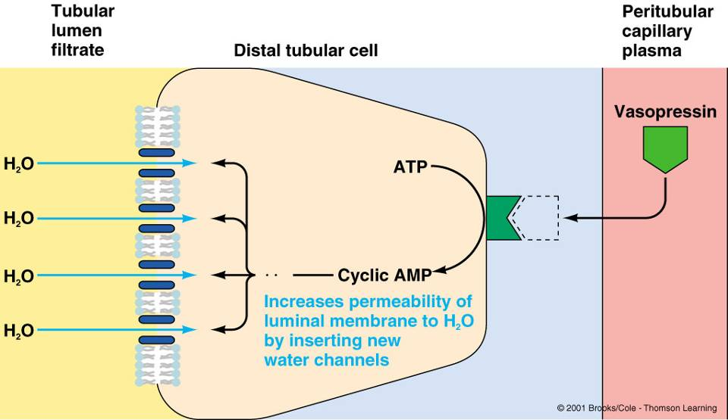
Facultative water reabsorption

Slide 103
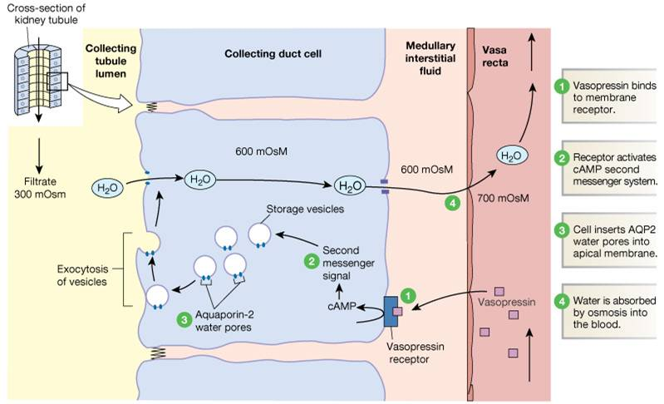
Formation of Water Pores:
Mechanism of Vasopressin Action

Slide 104
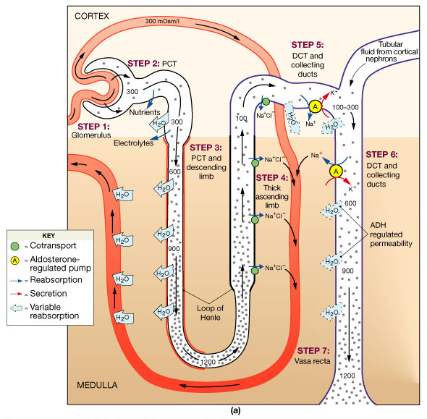
A Summary of Renal Function

Slide 105
Regulation of the Urine Formation
I. Autoregulation of the renal reabsorption

Slide 106
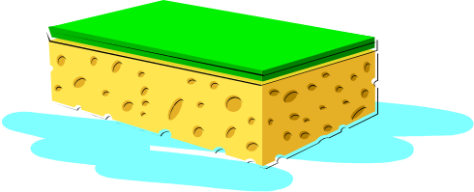
Solute Diuresis
= osmotic diuresis
large amounts of a poorly reabsorbed solute such as glucose, mannitol, or urea

Slide 107
Osmotic Diuresis
Normal Person
Water restricted
Normal person Mannitol Infusion
Water Restricted
Cortex
M
M
Na
M M M
M
H₂0
Na
Na
H₂0
H₂0
Na
H₂0
H₂0
H₂0
M
Na
Medulla
M
M
Na
M
Urine Flow Low
Uosm 1200
Urine Flow High
Uosm 400

Slide 108
Osmotic Diuresis
Na
Na
Na
H₂0
H₂0
H₂0
Poorly reabsorbed
Osmolyte
Hypotonic
Saline
H₂0
H₂0
H₂0
Osmolyte = glucose,
mannitol, urea
Na
Na
Na

Slide 109
2. Glomerulotubular Balance
Concept: The constant fraction (about 65% - 70%) of the filtered Na⁺ and water are reabsorbed in the proximal tubular, despite variation of GFR.
Importance: To prevent overloading of the distal tubular segments when GFR increases.
Glomerulotubular balance acts as a second line of defence to buffer the effect of spontaneous changes in GFR on urine output.
(The first line of defense discussed above includes the renal autoregulatory mechanism, especially tubuloglomerular feedback, that help to prevent changes)

Slide 110
Glomerulotubular balance: Mechanisms
GFR increase independent of the GPF -- The peritubular capillary colloid osmotic pressure increase and the hydrostatic pressure decrease – The reabsorption of water in proximal tubule increase

Slide 111
II Nervous Regulation

Slide 112
INNERVATION OF THE KIDNEY
Nerves from the renal plexus (sympathetic nerve) of the autonomic nervous system enter kidney at the hilus→innervate smooth muscle of afferent & efferent arterioles→regulates blood pressure & distribution throughout kidney
Effect: (1) Reduce the GPF and GFR and through contracting the afferent and efferent artery (α receptor)
(2) Increase the Na⁺ reabsorption in the proximal tubules (β receptor)
(3) Increase the release of renin (β receptor)

Slide 113
Nerve reflex:
1. Cardiopulmonary reflex and Baroreceptor Reflex
2. Renorenal reflex
Sensory nerves located in the renal pelvic wall are activated by stretch of the renal pelvic wall, which may occur during diuresis or ureteral spasm/occlusion.
Activation of these nerves leads to an increase in afferent renal nerve activity, which causes a decrease in efferent renal nerve activity and an increase in urine flow rate and urinary sodium excretion.
This is called a renorenal reflex response.

Slide 114
The series of mechanisms leading to activation of renal mechanosensory nerves include:
Increased renal pelvic pressure increases the release of bradykinin which activates protein kinase C which in turn results in renal pelvic release of PGE₂ via activation of COX-2.
PGE₂ increases the release of substance P via activation of N-type calcium channels in the renal pelvic wall.

Slide 115
III. Humoral Regulation
1. Antidiuretic Hormone (ADH)

Slide 116
Retention of Water is controlled by ADH:
  Anti Diuretic Hormone
  ADH Release Is Controlled By:
    Decrease in Blood Volume
    Decrease in Blood Pressure
    Increase in extracellular fluid (ECF) Osmolarity

Slide 117
Secretion of ADH
Urge to drink
STIMULUS
Increased osmolarity
Post. Pituitary
ADH
cAMP
+

Slide 118
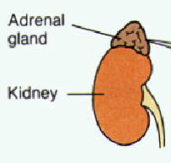
2. Aldosterone
Sodium Balance Is Controlled By Aldosterone
  Aldosterone:
    Steroid hormone
    Synthesized in Adrenal Cortex
    Causes reabsorbtion of Na⁺ in DCT & CD
      Also, K+ secretion

Slide 119
Effect of Aldeosterone:
The primary site of aldosterone action is on the principal cells of the cortical collecting duct.
The net effect of aldosterone is to make the kidneys retain Na⁺ and water reabsorption and K⁺ secretion.
The mechanism is by stimulating the Na⁺ - K⁺ ATPase pump on the basolateral side of the cortical collecting tubule membrane.
Aldosterone also increases the Na⁺ permeability of the luminal side of the membrane.

Slide 120


Slide 121
Rennin-Angiotensin-Aldosterone System
Fall in NaCl, extracellular fluid volume, arterial blood pressure
Angiotension III
Helps
Correct
Juxtaglomerular
Apparatus
Adrenal
Cortex
Angiotensinase A
Liver
Renin
Lungs
+
Converting
Enzyme
Angiotensinogen
Angiotensin I
Angiotensin II
Aldosterone
Increased
Sodium
Reabsorption

Slide 122
Regulation of the Renin Secretion:
Renal Mechanism:
Tension of the afferent artery (stretch receptor)
Macula densa (content of the Na+ ion in the distal convoluted tubule)
Nervous Mechanism:
Sympathetic nerve
Humoral Mechanism:
E, NE, PGE₂, PGI₂

Slide 123
3. Atrial natriuretic peptide(ANP)
ANP is released by atrium in response to atrial stretching due to increased blood volume
ANP inhibits Na⁺ and water reabsorption, also inhibits ADH secretion
Thus promotes increased sodium excretion (natriuresis) and water excretion (diuresis) in urine

Slide 124

Renal Response to Hemorrhage
2934

Slide 125
IV Micturition
Once urine enters the renal pelvis, it flows through the ureters and enters the bladder, where urine is stored.
Micturition is the process of emptying the urinary bladder.
Two processes are involved:
The bladder fills progressively until the tension in its wall rises above a threshold level, and then
A nervous reflex called the micturition reflex occurs that empties the bladder.
The micturition reflex is an automatic spinal cord reflex; however, it can be inhibited or facilitated by centers in the brainstem and cerebral cortex.

Slide 126

Urine Micturition
stretch
receptors

Slide 127
1) APs generated by stretch receptors
2) reflex arc generates APs that
3) stimulate smooth muscle lining bladder
4) relax internal urethral sphincter (IUS)
5) stretch receptors also send APs to Pons
6) if it is o.k. to urinate
  APs from Pons excite smooth muscle of bladder and relax IUS
  relax external urethral sphincter
7) if not o.k.
  APs from Pons keep
  EUS contracted
stretch
receptors

Slide 128
Changes with aging include:
Decline in the number of functional nephrons
Reduction of GFR
Reduced sensitivity to ADH
Problems with the micturition reflex

